Slide 1
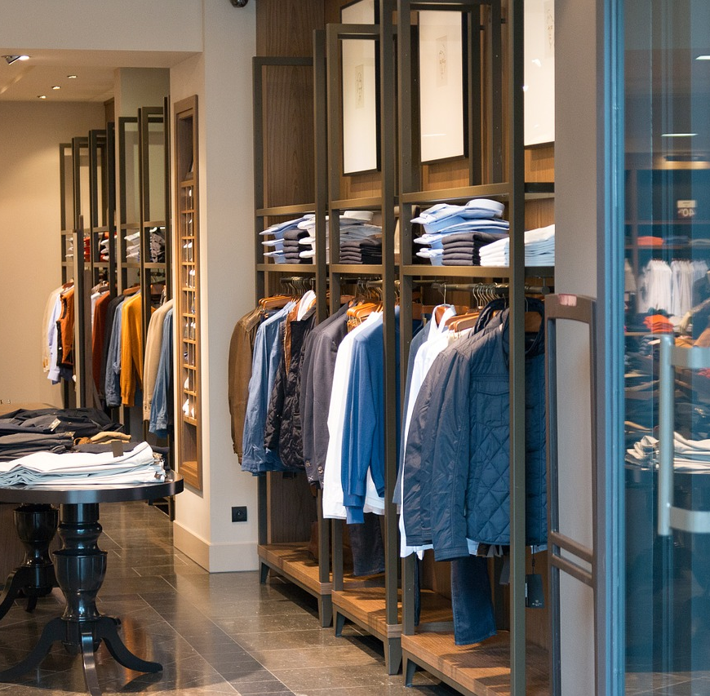
Custom Clothing Athens
Daniel Saul
Kwokpan Lui
Wes Purcell

Slide 2

Outline
Scenario Flowcharts
Store/Inventory Report
Customer Order
Scenario Demonstrations
Inventory Scenario
Orde Scenario
System UML
Data Type Justification
Arrays
ArrayLists
HashSets
HashMaps
OOP Principle Implementation
Inheritance
Encapsulation
Polymorphism

Slide 3
Scenario Flowcharts

Slide 4
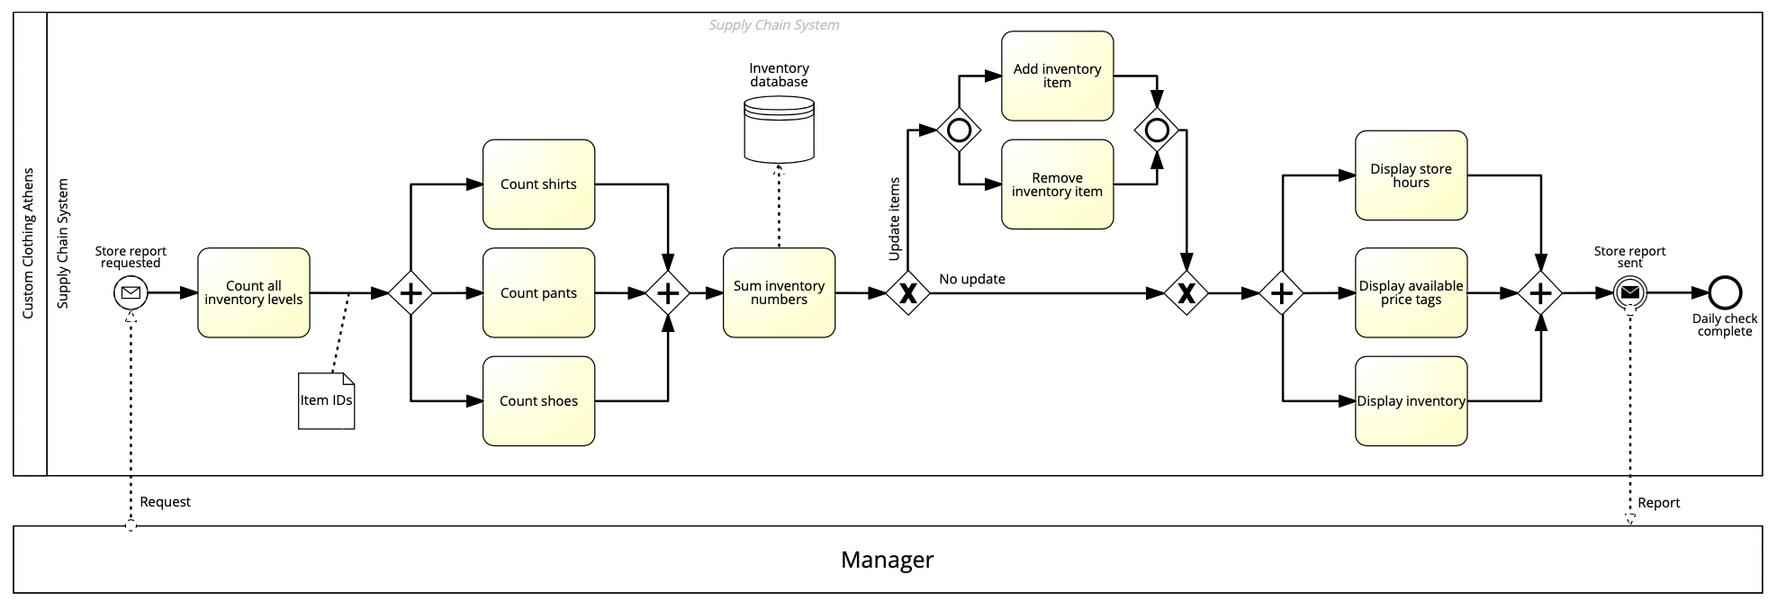
Store/Inventory Report

Slide 5
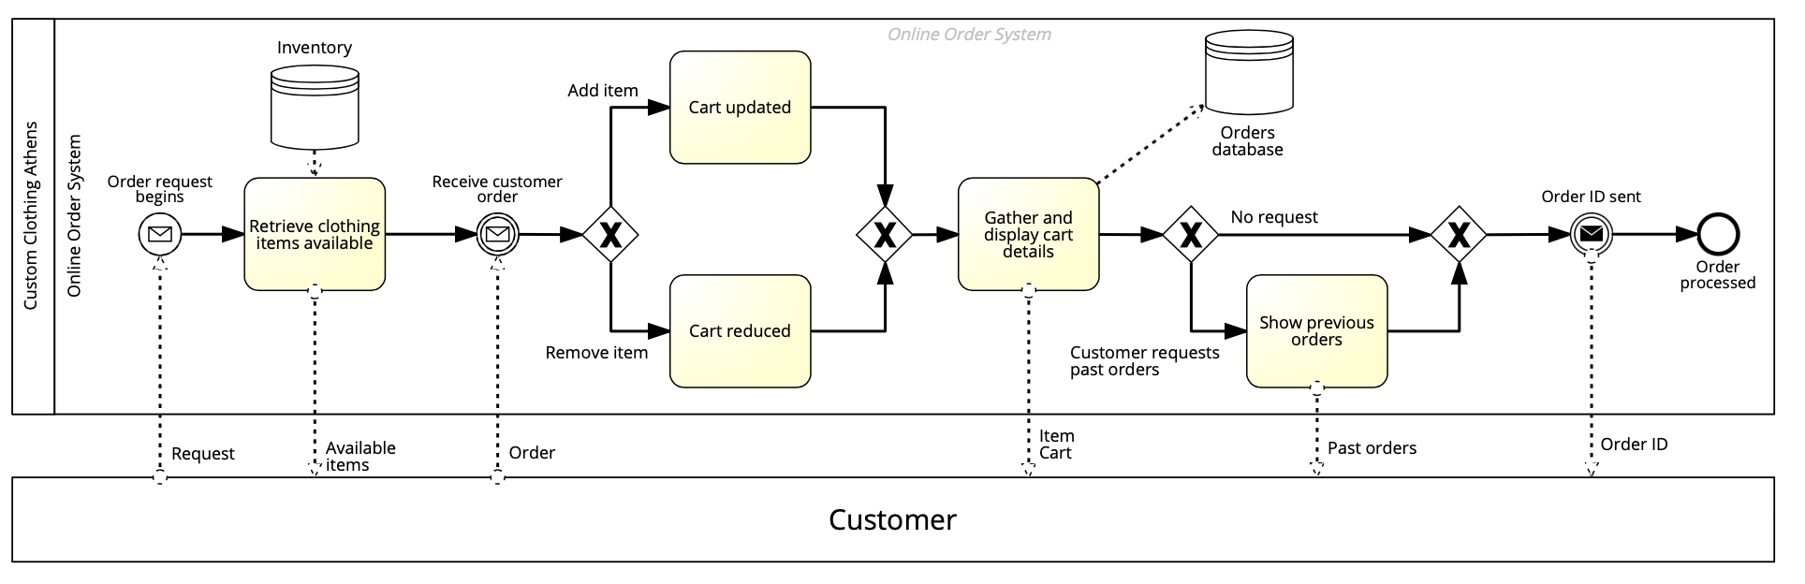
Customer Order

Slide 6
Scenario Demonstrations

Slide 7
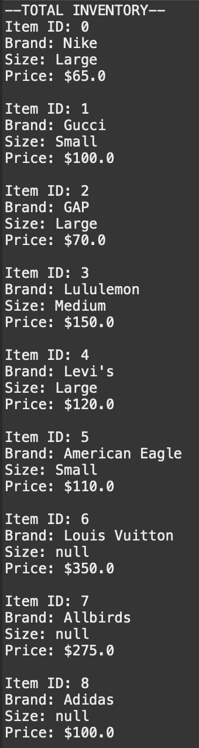
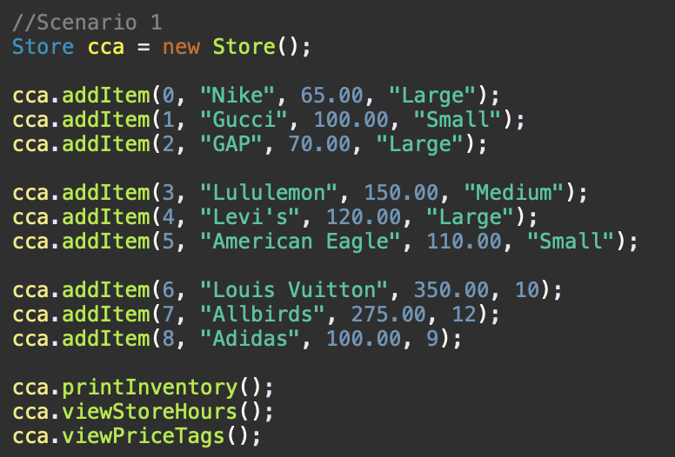
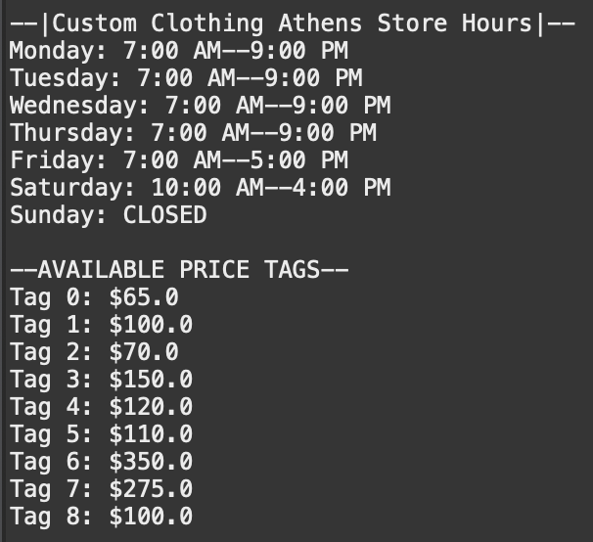
Store/Inventory Report
Daily store reports are essential for the efficiency and success of retail businesses. Our scenario shows a manager requesting a report for the availability of items and store information. Our application returns each item in the inventory, price tags available, and the physical store hours for the use of the manager.

Slide 8
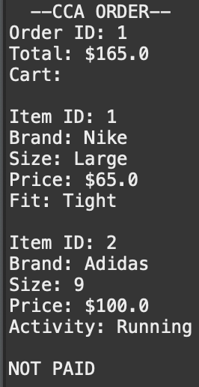
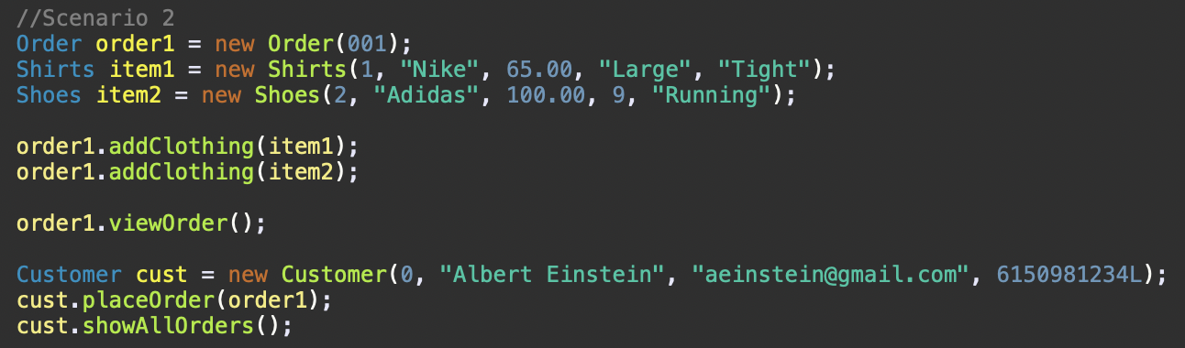
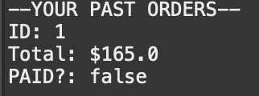
Customer Order
The most important transaction for a business is customer demand and customers placing orders. Our scenario shows the process a customer goes through to place an order. Items are pulled from the inventory and added to an order. Obviously, customers can place multiple orders so those can be displayed upon request as well.

Slide 9
Custom Clothing Athens System UML Diagram

Slide 10
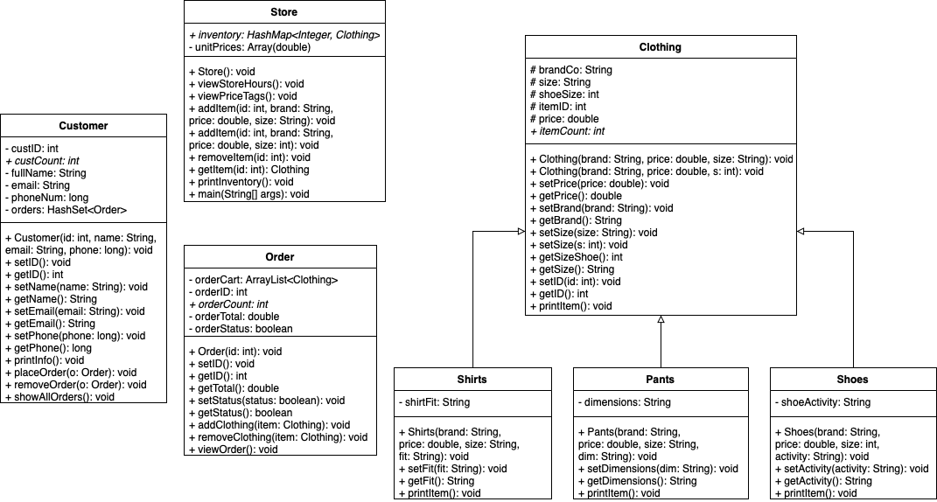
System UML

Slide 11
Data Type Justification

Slide 12
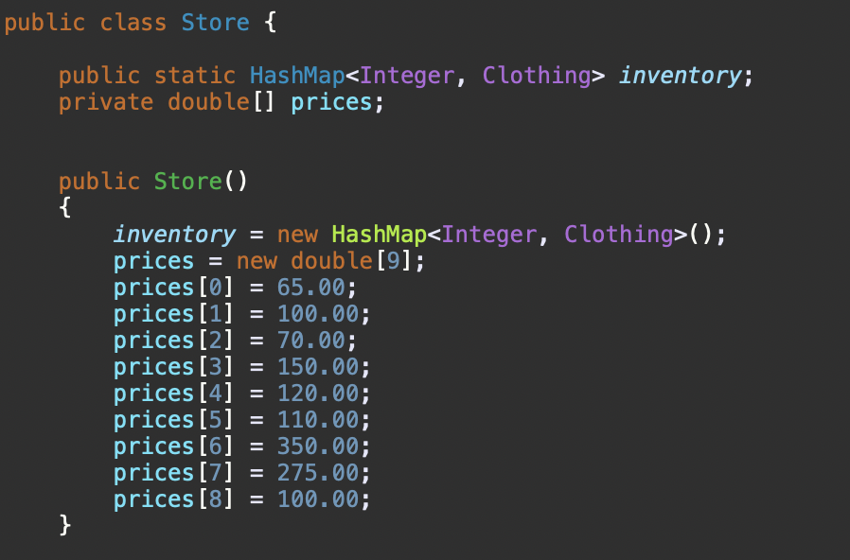
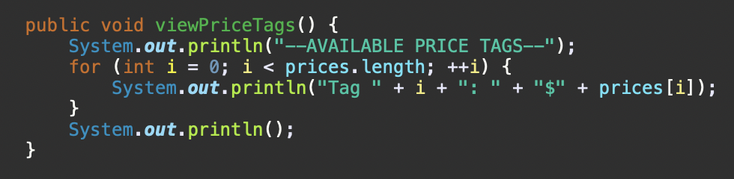

Arrays
We used an Array to store a collection of the available price tags for products in the physical store of Custom Clothing Athens. Since we only have a set amount of prices for certain products, we can use the Array’s properties of having a finalized number of elements for the “prices” Array. The prices are displayed through a method to offer the manager a preview of the tags we have in store.

Slide 13
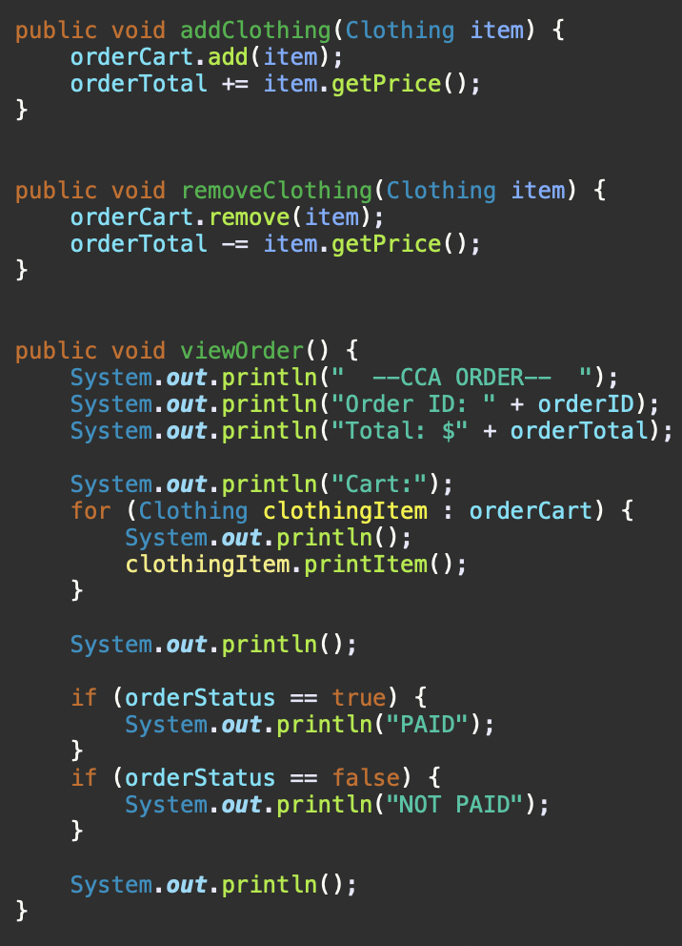
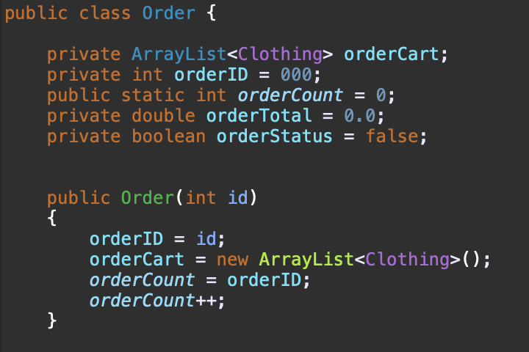
ArrayLists
We used an ArrayList to store a list of product objects of type Clothing to replicate an order cart in our online store. This collection type fits best with the Order class because there are always new items being added to the cart, so there will never be a set size to the list. The clothing objects being stored in order from when they were entered also helps show the customer which items, they had added first, likely being the most important item wanted. Products can be added and removed with ease.

Slide 14
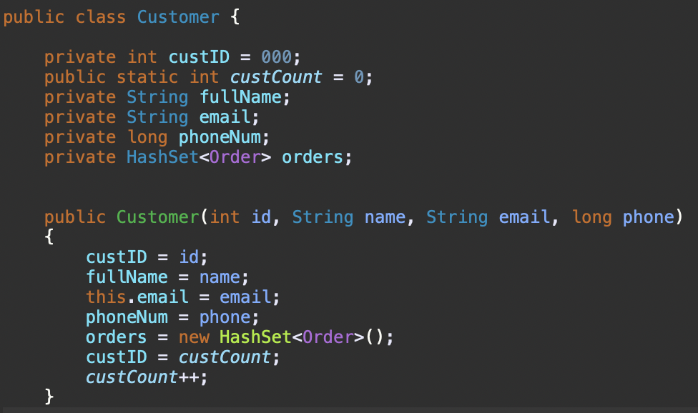
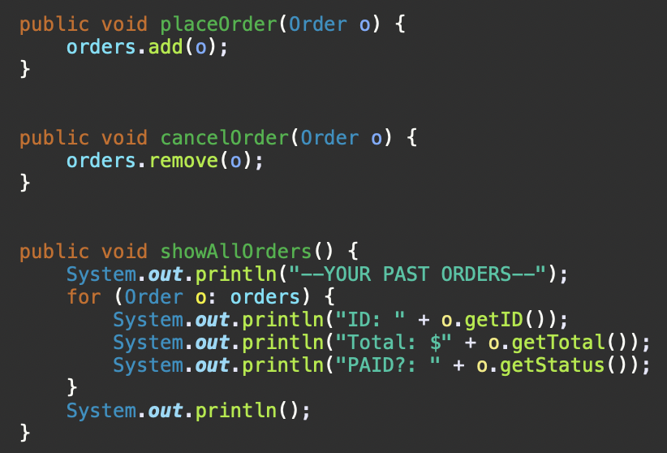
HashSets
We used a HashSet in our Customer class to store the orders of type Order a customer has or has placed. In any retail situation, customers tend to place more than one order in a given time. We chose the HashSet in this situation because the orders don’t need to be stored in a specific sequence and can be placed or canceled without a lengthy process. The methods used with this collection place, cancel, and display all orders of a customer.

Slide 15
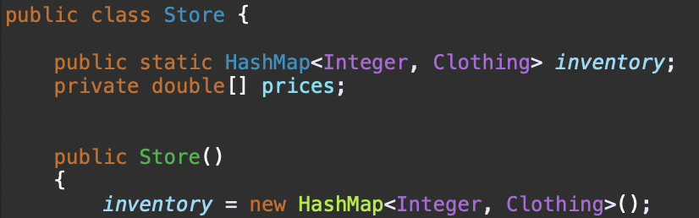
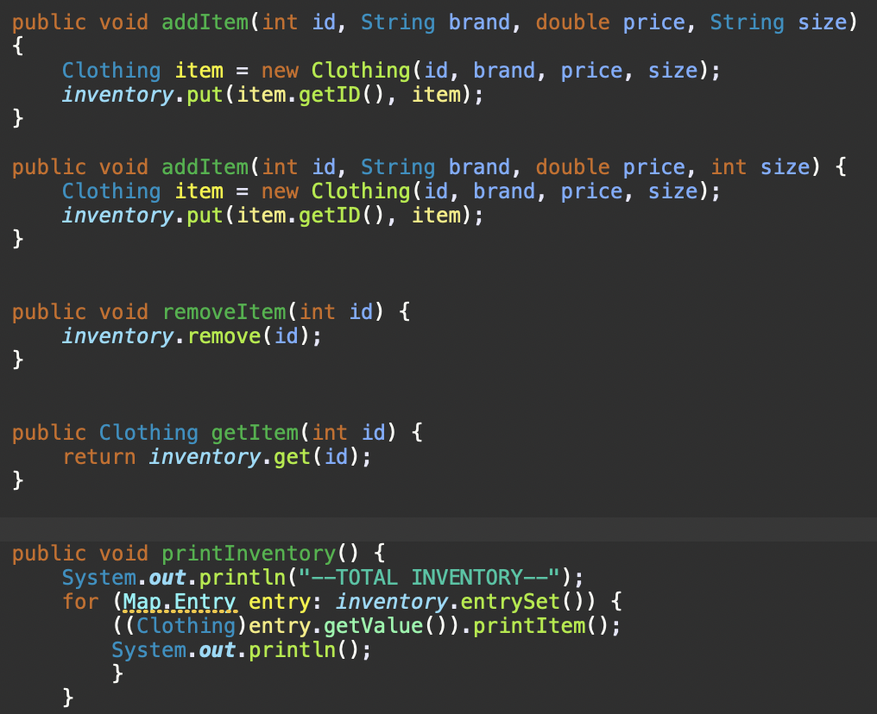
HashMaps
We chose to use a HashMap collection type to store the products we have in inventory in either our warehouse or store. The key is the ID of the product, and the value is the information of the product. This allows a manager to easily view a product or all the products we have in stock. The products do not need to be in a specific order in the Map because they can be gathered or searched just with the item ID.

Slide 16
OOP Principle Justification

Slide 17
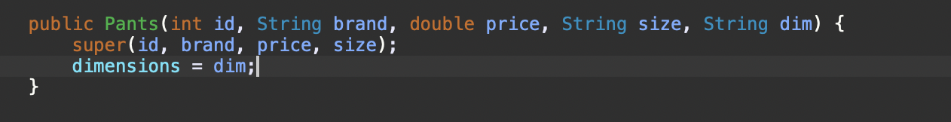
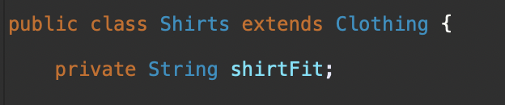
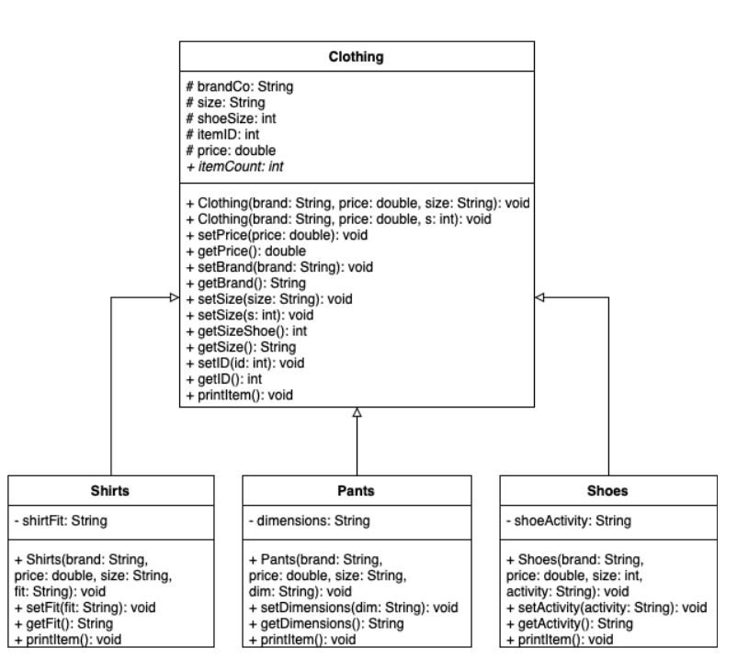
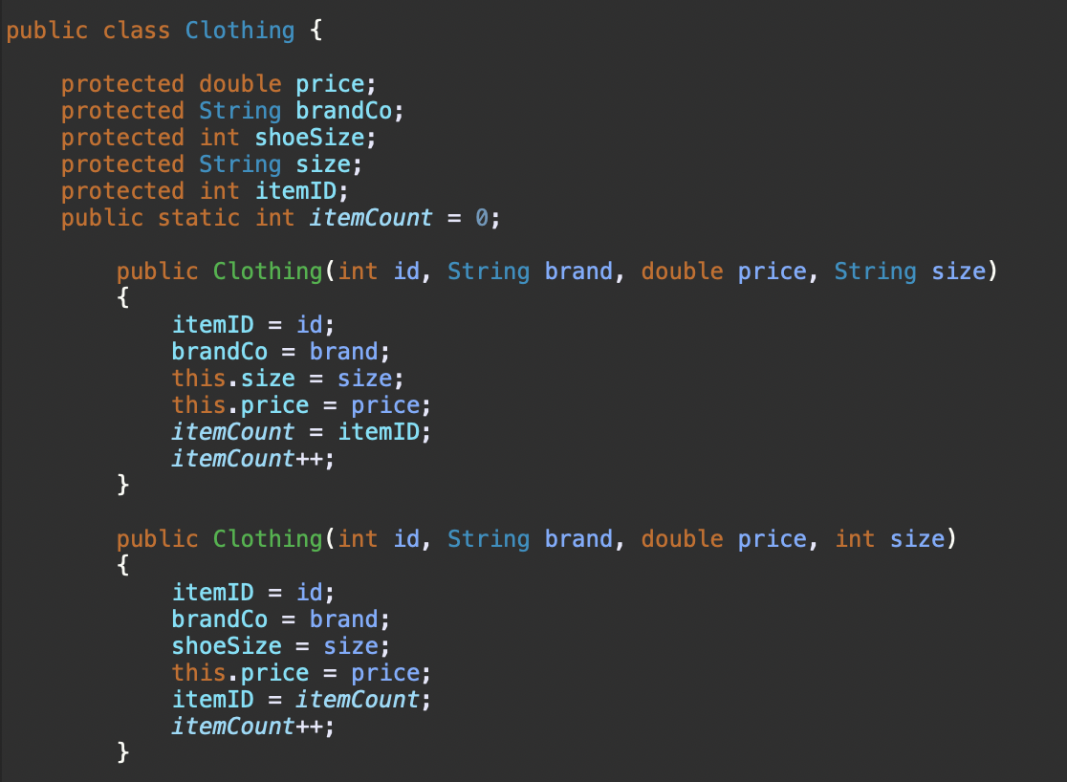
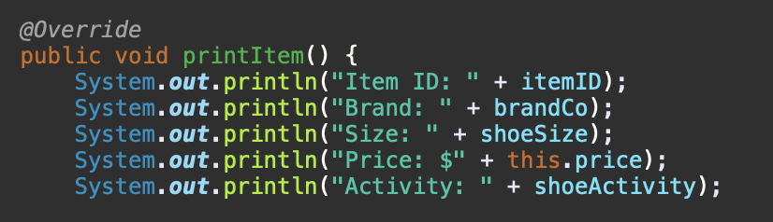
Inheritance
We used inheritance through our clothing class and its subclasses. The pants, shoes, and shirts are articles of clothing (is-a relationship).These subclasses can use methods and variables interchangeably with the clothing class. The protected attributes allow the subclasses to have access to the main class attributes. Inheritance allows us to manipulate existing code to save time and simplify the code. It allows the users to be more specific.

Slide 18
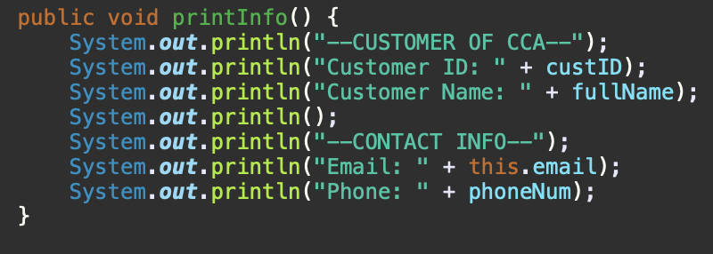
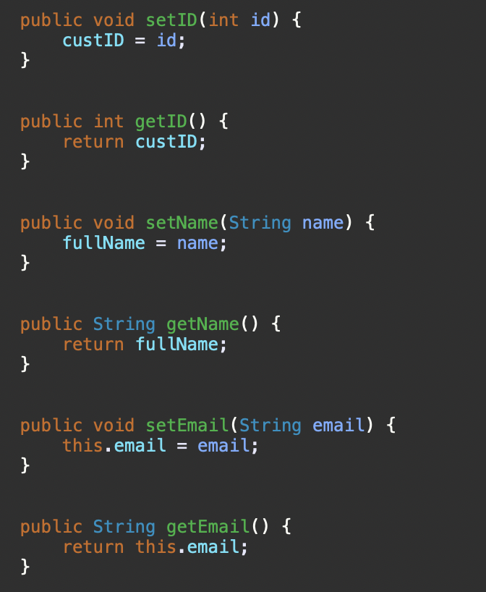
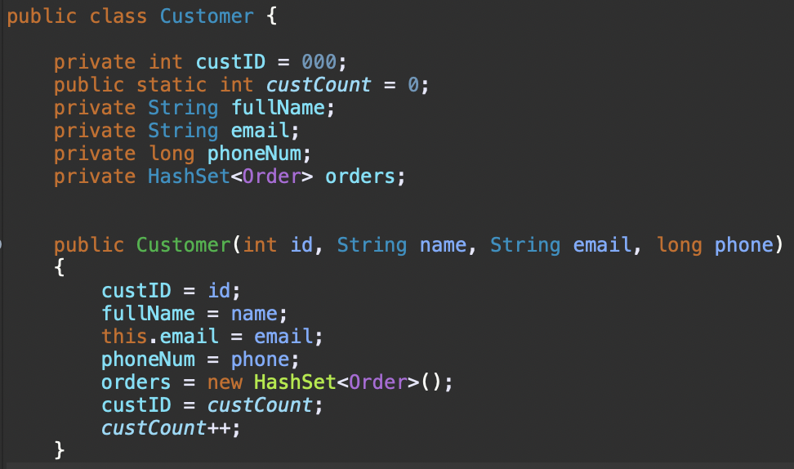
Encapsulation
Encapsulation allows us to keep our implementation private. This prevents the class user from knowing how our methods work. Our customer class attributes can only be changed through public methods in order to protect the data. Our private attributes of custID, custCount, fullName, etc can only be set, got, or printed by the user.

Slide 19

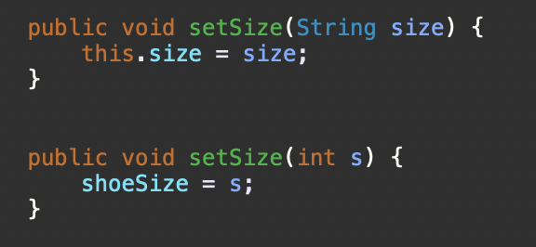
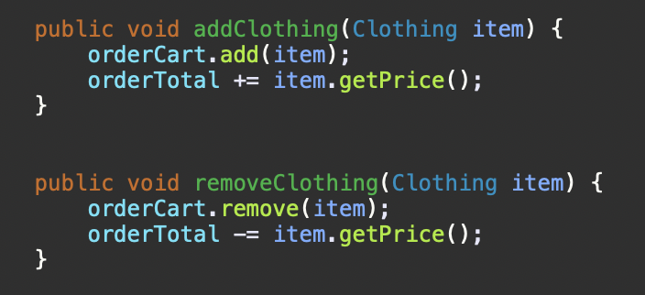
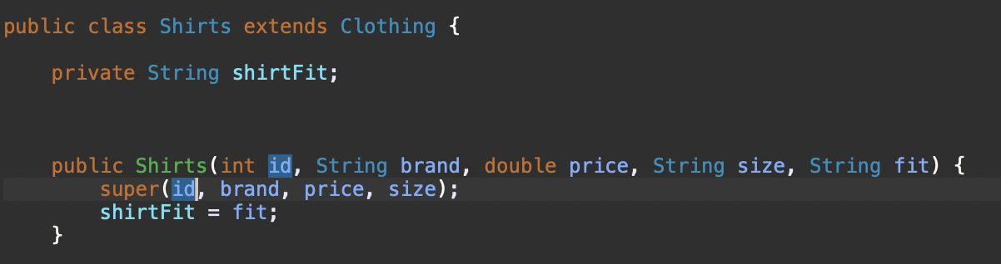
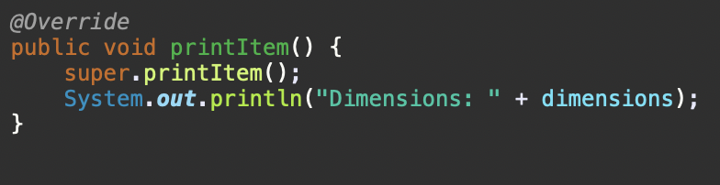
Polymorphism
We used polymorphism all throughout our Custom Clothing Athens application. We used method overloading (compile-time polymorphism) within the Clothing class in the instance of a clothing item either having a regular string size, or int size of a shoe. For runtime polymorphism, we implemented three collections that store an object of a certain collection data type. Our ArrayList stored objects of type Clothing to act as a shopping cart in an order, HashMap stored objects of type clothing for inventory, and HashSet stored objects of type order for a customer. We also used these derived classes to demonstrate polymorphism through the usage of their methods via extension and reference conversion.
Notes:
Polymorphism means more than one form. There are two different types of polymorphism. Compile-time and runtime. We implement (whatever we implemented) because… This polymorphic method behaves differently in different situations.

